Slide 1
Methods for Materials Diagnostics
Edmund (Edo) Dobročka
1975-1980 – Faculty of Mathematics and Physics, Charles University, Prague,
1980 -1991 – IEE SAS – X-ray topography, dislocations in Si substrates
and GaAs crystals
1991-2005 – Faculty of Mathematics and Physics, Comenius University, Bratislava,
lectures on X-ray diffraction methods, dislocations in solids
2004 -2015 – Faculty of Electrical Engineering, STU, Bratislava (part time job)
lectures on X-ray diffraction methods
2005 - ?? – IEE SAS, X-ray diffracion, high power diffractometer
Bruker D8 DISCOVER with rotating anode

Slide 2
Methods for Materials Diagnostics
Introduction. Non-crystalline state. Hard-Sphere models, Random-Walk models,
Fractal models.
Crystalline state. Symmetry, symmetry operations, space lattice, unit cell, primitive
cell. Miller indices, crystallographic symbols. Crystallography in two dimensions.
Crystallography in three dimensions. Crystal systems, Bravais lattices, point groups,
space groups.
Symmetry and the properties of crystals. Neumann, Curie and Voigt principles.
Examples of structures. Imperfections in crystals and their experimental
observation. Point defects, dislocations, stacking faults.
Diffraction methods. Laue equations, reciprocal lattice, Ewald construction, Bragg
equation. Diffraction indices, atomic form factor, structure factor, intensity of
diffracted radiation.
Basic X-ray diffraction experiments, Debye-Scherrer method, Laue method, X-ray
diffractometry. Bragg-Brentano set-up, double axis and triple axis diffractometry.
Imaging methods, X-ray topography.

Slide 3
Literature
Samuel M. Allen, Edwin L. Thomas: The Structure of Materials,
John Wiley & Sons, Inc., New York 1998, USA
J. C. Anderson, K. D., Leaver, R. D. Rawlings, J. M. Alexander:
Materials Science, Stanley Thornes (Publisher) Ltd, Cheltenham 1998, UK
J. F. Nye: Physical Properties of Crystals, Clarendon Press, Oxford 2006, UK
R. W. James: The optical Principles of Diffraction of X-Rays, Ox Bow Press,
Woodbridge, Connecticut 1948, USA
B. E. Warren: X-Ray Diffraction, Addison-Wesley, London 1969, UK
M. Birkholz: Thin Film Analysis by X-Ray Scattering, Wiley-VCH Verlag
GmbH & Co. KGaA, Weinheim 2006, Germany
V. Valvoda, M. Polcarová, P. Lukáč: Základy strukturní analýzy,
Karolinum, Praha 1992

Slide 4
Introduction
Material Science and Engineering (MSE) – multidisciplinarity
MSE tetrahedron
Structure
Properties
Processing
Performance
ideal – perfect crystal
role of lattice defects – important!!
point defects – microelectronics
not always the best solution
dislocations – plasticity in metalurgy
New discipline – defect engineering!

Slide 5
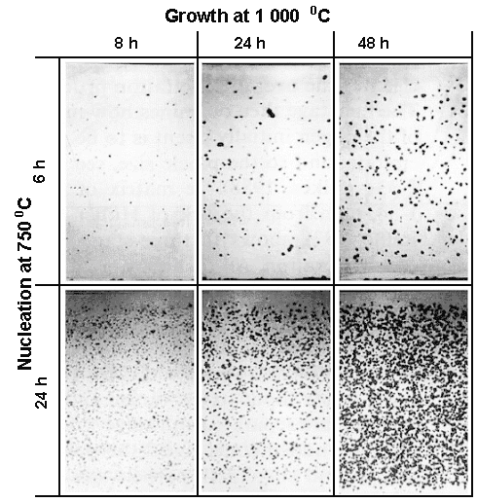
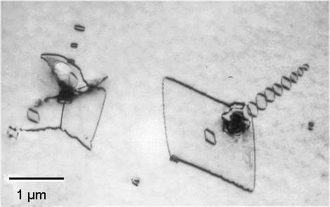
Defect engineering - example
Intrinsic gettering in Si wafers
growth of SiO_{x} precipitates
dislocation loops punching
from SiO_{x} precipitates
denuded zone
efficient sinks of
lifetime killers (Au, Pt, Ni,..)

Slide 6
Structure – “definition”
quantitative description of the arrangements of the components that make up
the material on all relevant length scales
chemical composition
arrangement
SiO₂
thermal expansion
coefficient (10⁻⁶ K⁻¹)
α₁ = 13
α₃ = 8
α = 0.5
(isotropic)
low quartz – kremeň
trigonal crystal
vitreous silica – kremenné sklo
amorphous

Slide 7
Descriptors (štruktúrne charakteristiky)
conceptual scheme that provides a precise quantitative characterization
of some aspect of structure
Examples:
bond length – dĺžka väzby
unit cell – elementárna (základná) bunka
symmetry elements – prvky symetrie
coordination number – koordinačné číslo
vacancy concentration – koncentrácia vakancií
grain size – veľkosť zŕn
correlation distance – korelačná vzdialenosť (dĺžka)

Slide 8
Chemical bond – chemická väzba
bond type bond energy
covalent ~ 5 eV (8×10⁻¹⁹ J)
metallic ~ 0.5 eV
ionic 1 – 3 eV
van der Waals 0.001 – 0.1 eV
bond length – dĺžka väzby 0.1 – 0.25 nm
bond angles – uhol medzi väzbami (for covalent bonds)
sp² – 120°
sp³ – 109.5°
orbital hybridisation – sp², sp³
sizes of atoms /ions – atomic radii – atómové polomery
depends on bond type

Slide 9
group of atoms
coordination number – koordinačné číslo
coordination shells – koordinačné sféry

Slide 10
group of atoms
packing fraction – miera zaplnenia
V_{i} – volume of individual structural
units (atoms, molecules...)
V_{T} – volume (macroscopic) of the sample
gases – V_{v} ~ 10⁻⁴
liquids and amorphous solids – V_{v} ~ 0.5

Slide 11
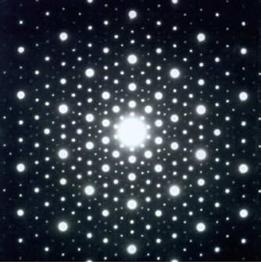
Classification of materials
non-crystalline state
(amorphous)
crystalline state
long range order – LRO
usporiadanosť na diaľku
short range order – SRO
usporiadanosť nablízko
tranlational symmetry!!
lack of tranlational symmetry!!
liquid crystals
statistical parameters
orientational order
quasicrystals
absence of translational symmetry or LRO
sharp diffraction spots in TEM

Slide 12
Non-crystalline state
liquid state – low viscosity kT > binding energy
glassy state – high viscosity kT < binding energy
similar structure – difference in dynamics
glass transition
liquid
V_{F}
V_{F} – free volume
volume
glass
V_{F}
crystal
melting
T_{g}
T_{m}
temperature

Slide 13
Pair distribution function
hard sphere model
gas
g(r)
liquid/glass
primitive cubic
monoatomic crystal
g(r)
g(r)
1
1
12
8
6
6
correlation
distance
2R₀
4R₀
r
2R₀
4R₀
r
2R₀
4R₀
r

Slide 14
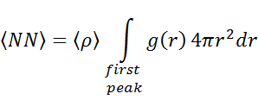
Hard sphere model – model tvrdých gúľ
average number of nearest neighbors
g(r)
r
Bernal – 1959 – Random close-packed sphere model
for fcc and hcp
NN = 12
V_{v} = 0.7405
packing fraction V_{v} ~ 0.64

Slide 15
Random walk models – modely náhodnej prechádzky
applications:
shapes of flexible polymer molecules
Brownian motion
diffusion
1, 2, 3 dimensions
constant or variable step length
motion on fixed lattice
motion in any direction

Slide 16
Random walk models – modely náhodnej prechádzky
step length – l
number of steps – n
uncorrelated motion
end-to-end
displacement – R_{n}
root-mean-square displacement
polymer chain
packing fraction
n spheres of diameter D₀

Slide 17
Fractal models
expanding – dilatation symmetry
fractal dimension D
fractal object with
“mass” M
size R
D is an integer for compact objects
M ~ R^{D}

Slide 18
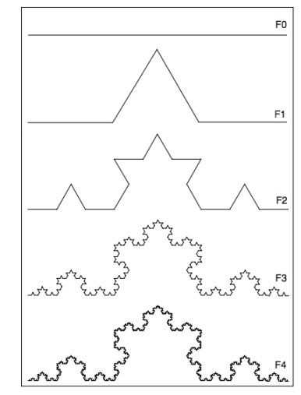
Examples
Menger sponge
Koch snowflake
polymer chain

Slide 19
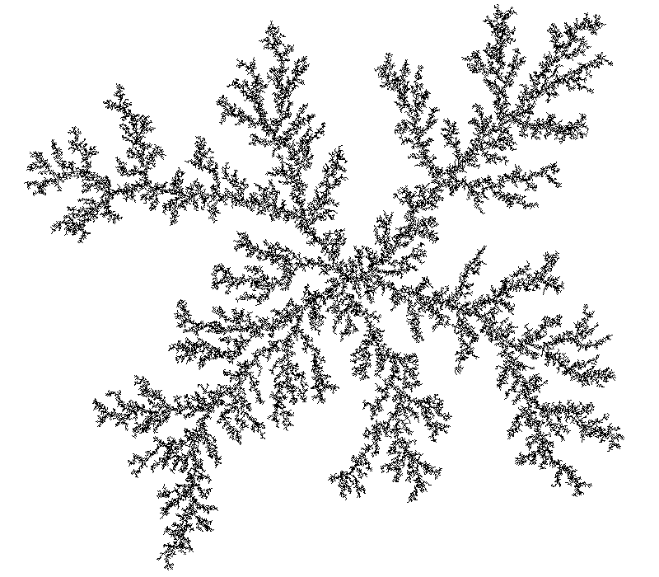
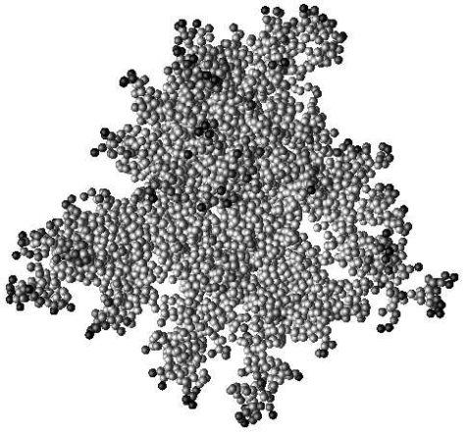
Fractals in material science
Diffusion-limited aggregation
simulation of growth
Self-regulating heaters
polyethylene-carbon black composite
particles form conductive
fractal structures
Fracture
correlation between
fracture toughness
and
the fractal dimension
of the fracture surface

