Slide 1
Diffraction
Literature:
V. Valvoda, M. Polcarová, P. Lukáč: Základy strukturní analýzy,
Karolinum, Praha 1992
M. Birkholz: Thin Film Analysis by X-Ray Scattering, Wiley-WCH,
Weinheim 2006
properties of X-rays, high-energy electrons
and neutrons used in diffraction analysis
geometrical principles of diffraction
    Diffracted intensity – kinematical & dynamical theory
    Basic experimental techniques
    X-ray diffractometry
    Bragg-Brentano geometry
    Grazing incidence diffraction
    Crystallite size
    High resolution set-up
    X-ray topography

Slide 2
Properties of X-rays, electrons and neutrons
X-rays electrons neutrons
charge 0 -e 0
rest mass 0 9.1×10⁻³¹ kg 1.67×10⁻²⁷ kg
energy ~ 10 keV ~ 100 keV ~ 0.03 eV
wave length 0.15 nm 0.004 nm 0.12 nm
Bragg angles large ~ 1° large
extinction length ~ 10 μm 0.03 μm 100 μm
absorption length 100 μm 1 μm 5 cm

Slide 3



Properties of X-rays, electrons and neutrons
X-rays electrons neutrons
rocking curve width 5” 0.6° 0.5”
refractive index n < 1 n > 1 n ≷ 1
atomic scatt. factors f 10⁻⁴ nm 1 nm 10⁻⁵ nm
dependence of f on Z ~ Z ~ Z^{2/3} irregular
anomalous dispersion common – rare
spectral width ~ 1 eV 3 eV 500 eV

Slide 4
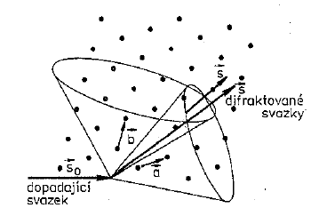





diffraction conditions – Laue equations
a, b, c
s
s₀
Laue equations

Slide 5








Concept of reciprocal lattice
scattering vector
reciprocal basis vectors
reciprocal lattice vectors

Slide 6



Concept of reciprocal lattice
conditions for diffraction are fulfilled
properties of reciprocal lattice vectors

Slide 7

Concept of reciprocal lattice
(120)

Slide 8
Looking for solution
s/λ
X-ray tube
s₀/λ
1/λ

Slide 9
Ewald construction
reciprocal
lattice
Ewald sphere
s/λ
X-ray tube
s₀/λ
polycrystalline
samples
sample
1/λ
origin of RL
Ewald construction is a graphical presentation
of the solution of Laue equations

Slide 10
Lattice planes in two-dimensional lattice
d_{hkl}
d_{hkl}
d_{hkl}
d_{hkl}

Slide 11

Bragg’s law
diffraction
triangle
θ
d_{hkl}
d sinθ
Miller indices (hkl)
diffraction indices hkl
(110)
110, 220, 440

Slide 12

Extinction length ξ
Extremely important parameter
I₀
I
depends on
hkl, λ,
material
I ≈ I₀ ??
D
Dimension of coherent region << ξ kinematical theory
Dimension of coherent region ≥ ξ dynamical theory

Slide 13




Diffracted intensity
Kinematical theory of diffraction – 1st Born approximation
hierarchy of scattering – calculation of amplitude
electron – scattering length b_{e} (scattering amplitude) [m]
~ classical radius of electron (Thomson)
r_{e} = 2.82×10⁻⁶ nm
intensity of unpolarized radiation scattered by one free electron

Slide 14

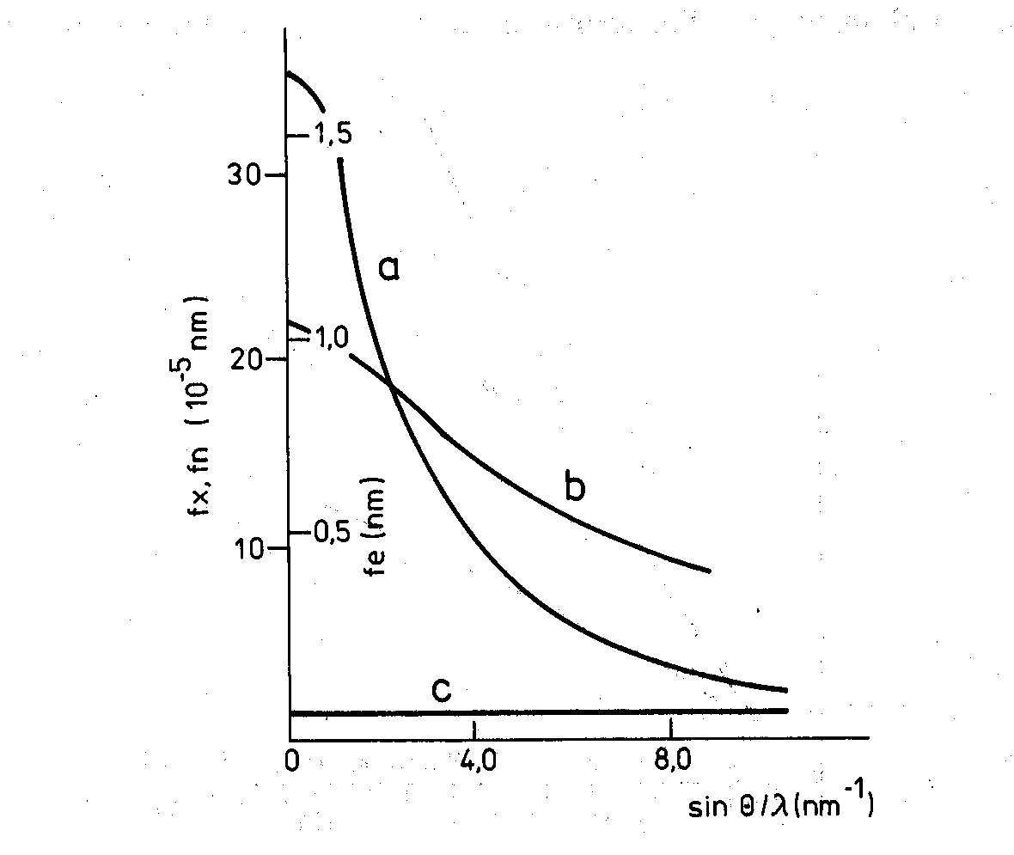



Diffracted intensity
atom – atomic form factor f – integration over the volume of atom
absolute units
electron units
Cromer-Mann coefficients a_{i}, b_{i}, c– tabulated
electrons
X-rays
f ’, f ” corrections for anomalous dispersion
for electrons
neutrons

Slide 15



Diffracted intensity
unit cell – structure factor F(S) – summation over all atoms in cell
x_{j}, y_{j}, z_{j} –
fractional coordinates
Debye-Waller factor
– mean squared
displacement
B_{j} – temperature factors
tabulated
extinction rules → type of lattice, symmetry elements

Slide 16
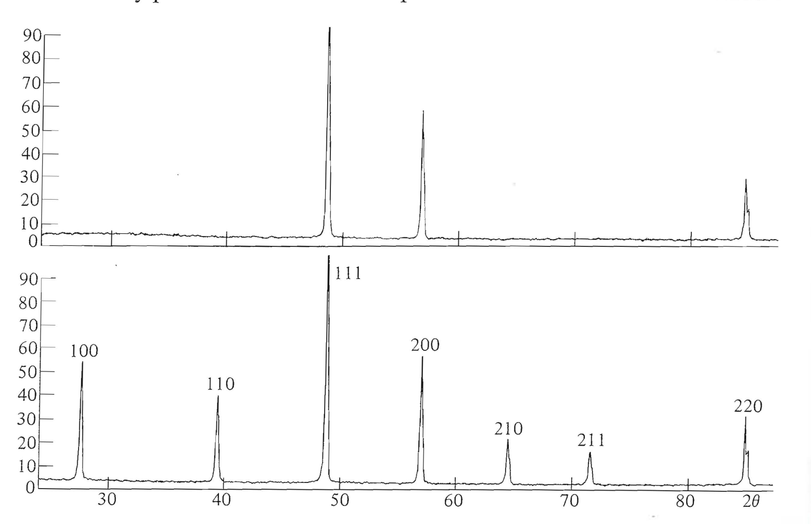
Structure factor – example
random occupation
75% Cu
25% Au
Cu
Cu₃Au – alloy
Au
disordered form – fcc
ordered form –
primitive cubic
quenching from 600°
annealing 20 days at 365°
and 40 days at 280°

Slide 17



Diffracted intensity
whole lattice – summation over all unit cells
→ interference function for intensity
lattice factor
intensity scattered by the whole crystal – interference function
complex number –
phase factor!
electron density
fundamental equation

Slide 18
Angular dependence of intensity
intensity
[atomic factor f(S)]²
Interference function
S ~ sinθ/λ

Slide 19
YBCO/sapphire
001
002
003

Slide 20




Measured intensity
maximum intensity
Integral intensity
area of the peak
for small single crystalline sample
p_{hkl} = 1
for polycrystalline sample
p_{hkl} = multiplicity factor
Lp – Lorentz-polarization factor
for small single
crystalline sample
V – irradiated volume
for polycrystalline
sample
quantitative analysis!

Slide 21



Parameters of diffraction peaks
FWHM or integral breadth β_{h} is affected by
instrumental broadening – g(2θ)
crystallite size – β ~ λ/(D cosθ)
(Scherrer equation)
microstrain – β ~ tanθ
planar lattice defects
(stacking faults, antiphase boundaries)
convolution of line profiles
Gaussian
Cauchy – Lorentz

Slide 22
Dynamical theory of diffraction
for (nearly) ideal large single crystals
Solution of wave equation in periodic medium (dielectric susceptibility)
refraction od X-rays – n = 1 – δ δ ~ 10⁻⁵ ÷10⁻⁶
multiple diffraction – interaction of diffracted and primary beam
Intensity I ~ |F(S)|

Slide 23
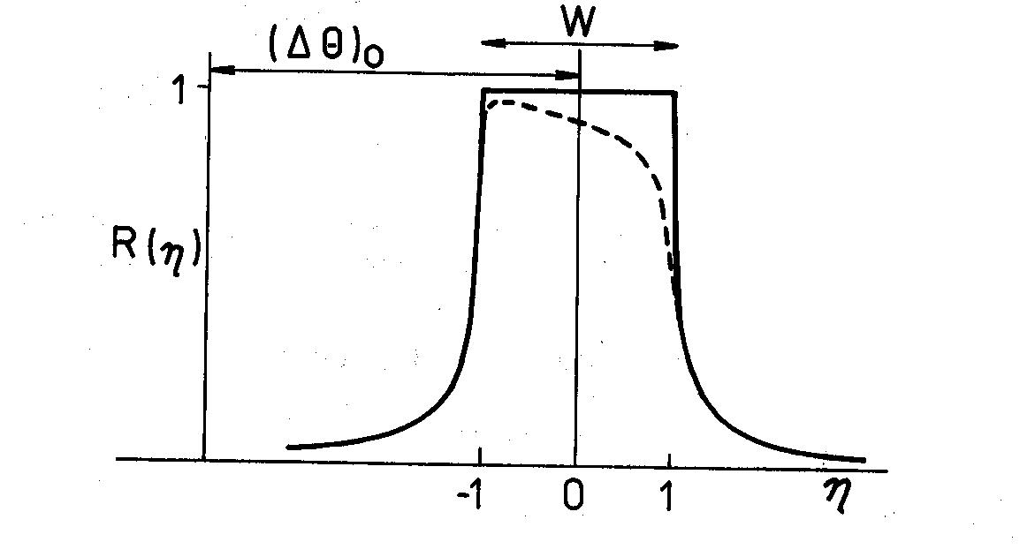
Rocking curve – perfect crystal, Bragg case
Darwin curve
Prins curve
typical values of W:
Si 004, Cu Kα₁ 3.83 "
Si 333, Mo Kα₁ 0.73 "
GaAs 004, Cu Kα₁ 8.55 "

Slide 24
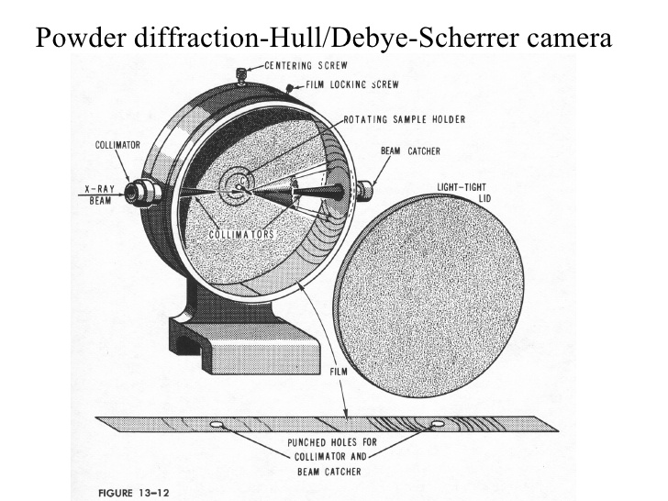
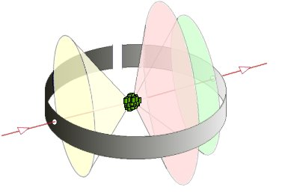
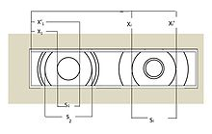
Debye-Scherrer method
measuring of lattice parameters of powder samples with high precision

Slide 25
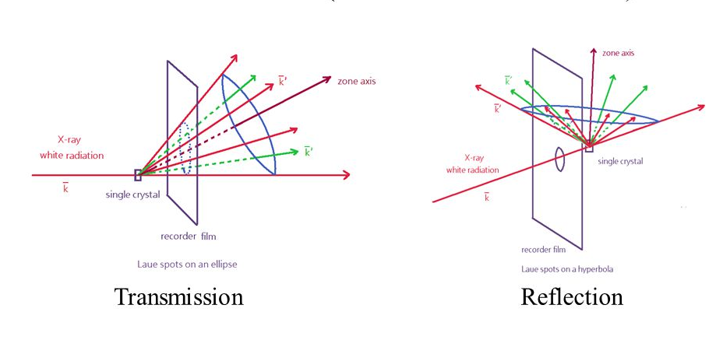
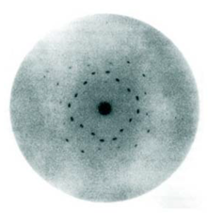
Laue method
orientation of single crystals
Laue – 1912
FMFI UK – 1992

Slide 26
X-Ray diffractometry
X-ray sources
sealed tubes ~ 1.5 kW
rotating anodes ~ 18 kW
synchrotron by orders of magnitude higher
goniometer
measuring the angles with precision ~ 0.0001°
PC controll
detectors
point – 0D
linear – 1D
area – 2D (films)

Slide 27

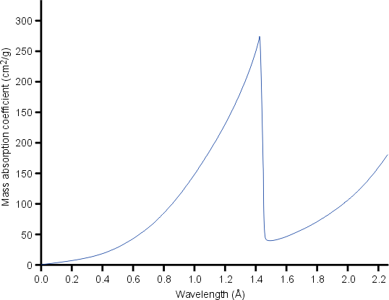
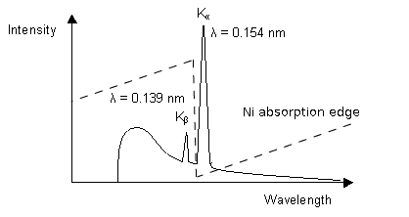
Absorption of X-rays
t
I₀
I
Lambert-Beer law
μ – attenuation coefficient
β filter

Slide 28
Symmetric θ/2θ (2θ/θ) measurement
incident
beam
diffracted
beam
θ
θ
sample
2θ
sample
surface
2 configurations of diffractometers – horizontal or vertical set-up
fixed sample, moving X-ray tube and detector (θ-θ)
fixed tube, moving sample (θ) and detector (2θ), ratio of speeds – 1:2

Slide 29
Diffraction in symmetric set-up
primary beam
Diffracting planes – parallel to the sample sufrace
Each diffraction originates from different assembly of crystallites

Slide 30
Bragg-Brentano set-up
focussing
circle
detector
detector slit
goniometer axis
sample
focus of
X-ray tube
Divergent primary beam irradiates the sample. All beams diffracted at different
parts of the sample are focused at the detector slit.

Slide 31
Diffraction pattern of MgB₂ wire in Ti sheath
MgB₂ and MgO phases are identified. Some peaks of Ti are also present. Red line is the simulated curve provided by software TOPAS 3.0 of Bruker company.

